Slide 1

Small Business

Slide 2

Small Business
More than 90% of Australian businesses are small businesses.
Small businesses employ less than 20 people (1-19 staff).
Industries with the largest number of small businesses (in descending order) are:
construction
professional, scientific and technical services
rental, hiring and real estate services
agriculture, forestry and fishing
financial and insurance services
Can you think of examples of a small businesses?

Slide 3

Types of Small Business
Three main types of small businesses are:
Manufacturing (making products) eg. Making toys.
2. Trading (selling already made products) This includes
- retail, a business that sells to the public. eg. newsagent.
- wholesale, a business that purchases products from the manufacturer and sells this to the retailer.
Service (selling a service) eg. Hairdresser,
bricklayer.

Slide 4

Questions:
What is a small business?
2. List the the three main types of small businesses
and give 3 examples of each of these businesses.
3. Explain the difference between wholesale and retail?
4. What is the difference between a retailing business and a service business?
5. What is the difference between a manufacturing business and a service business?

Slide 5

Types of Small Business Ownership
The most common business ownership structures are:
A sole trader
2. A partnership
A company

Slide 6

Sole Trader
The most common form of business ownership in Australia is the sole trader.
A sole trader is a business owned by one
person.
The owner may work alone or employ staff.
If the sole trader trades under their own name, they do not have to register the name eg. Greg Smith. However if the name is not the owner’s name eg. Greg’s mowing, then the business name must be registered.
A sole trader is not a separate legal entity, the tax file number of the individual is used. However, the business will need its own Australian Business Number (ABN).

Slide 7

Sole Trader
Advantages include:
The owner is the boss and can make all the decisions.
The owner keeps all the profit.
The business is easy to establish, as it is the easiest and least expensive to commence.
The business is usually relative finish to wind up when the owner wants to cease operating.

Slide 8

Sole Trader
Disadvantages include:
Financial resources are limited to those that
the owner can gain access to. This can limit
expansion of the business.
2. The owner has unlimited liability. This means should the business go
bankrupt then the personal assets of the owner eg. house, car, boat
can be used to cover any outstanding debts.
Should the owner become ill or need to be absent (eg. holidays) there
may be a problem if there is no-one to replace him or her.
4. Losses can not be shared with other owners.
5. With one owner there may be limited sources of advice for making
business decisions.

Slide 9
Questions:
What is a sole trader? Give 3 examples.
2. List 3 advantages of being a sole trader.
3. Select what you believe to be the best advantage of being a sole trader and justify why you believe this.
4. In your own words explain 2 disadvantages of being a sole trader.

Slide 10

Partnerships
A partnership exists when two or more people (but no more than 20, with some exemptions) go into business together.
In Australia, the number of partners allowed in a Partnership is restricted by law to between 2-20 people. However there are exemptions including:
An accounting firm can have up to 1,000 partners
A legal firm can have up to 400 partners
A firm of medical practitioners can have up to
50 partners.

Slide 11

Partnerships
If a partnership is named using the partners names eg. Smith and Jones, than it is not required by law to register the name. However if the partnership does not use their personal names in the partnership name eg. Just Nails, than the partnership name would have to be registered.
A partnership has its own tax file number, Australian Business Number (ABN) and lodges a separate tax return.

Slide 12

Partnership Agreement
Partnerships are regulated by the Partnership Act 1895 as well as by a Partnership Agreement if the partners have one.
A Partnership Agreement can set out the rights, liabilities and duties of the partners. It can set out the splitting of profits, the aims of the partnership and procedures for replacing and/or retiring partners.
A Partnership Agreement is a legally binding document that can help to resolve any disputes between partners. It is best to
have the agreement drawn up by a legal
professional.

Slide 13

Partnership
Advantages:
The biggest advantage is that more money (capital) can be raised in a partnership rather than a sole trader. This is because each partner can be contributing capital. Usually the more partners, the more capital available.
Partnerships are ideal to bring together people of different skill or knowledge.
Partners are able to share workloads. This gives more flexibility for absences and holidays of partners.
Risks and any losses can be shared by the
partners.

Slide 14

Partnership
Disadvantages:
The partnership has unlimited liability. This means all partners are liable for any debts or obligations that the partnership incurs. If the partnership becomes bankrupt than the partners’ private assets will need to be used to settle the debts.
The partnership may have a limited life. If one partner dies the partnership may dissolve, depending on the terms of the Partnership Agreement.
Profit are shared depending on the terms
of the Partnership Agreement.
4. Decisions may take time to reach and
disagreements can occur.

Slide 15

Questions:
How many people are allowed in a partnership
in Australia?
2. What is a Partnership Agreement?
3. List 2 reasons it is important to have a Partnership Agreement.
4. List 3 things that would be important to have in a Partnership Agreement.
5. In your own words explain 3 advantages and 2 disadvantages of operating as a partnership.

Slide 16

Companies
A company is a separate legal entity established under the Corporations Act 2001. The Australian Securities and Investment Commission (ASIC) enforces company laws to protect consumers, investors and creditors.
A proprietary company can not raise money from the public. A proprietary company must have 1 shareholder with a maximum of 50 non-employee shareholders. A proprietary company must have ‘Pty’ or ’Proprietary’ included in its name.
If the liability of a proprietary company’s members are
limited to the amount unpaid on their shares, the
company’s name must end with ‘Pty Ltd’ or
’Proprietary Limited’.

Slide 17
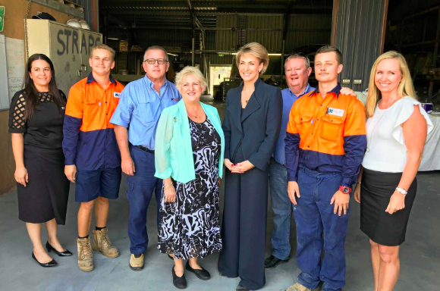
Companies
To be classified as a small proprietary company as opposed to ‘large’, at least two of the following criteria need to be met by the end of the financial year:
assets of less than $12.5 million
fewer than 50 employees
consolidated revenue of less than $25 million.

Slide 18
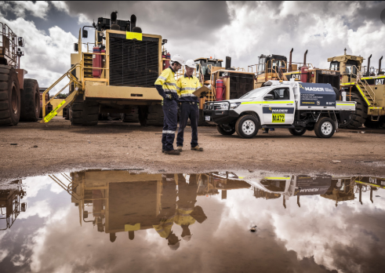
Companies
Advantages:
Members (or shareholders) have limited liability, which is usually limited to the value of their shares. Personal assets are safe should the company get into financial difficulty.
Transfer of ownership is relatively simple.
The continuity of the company’s existence is not dependent on the owners. The death of a shareholder does not end the company.
It can be easier to raise capital because there are
more potential owners of the business.

Slide 19

Companies
Disadvantages:
There are increased legal requirements and greater regulation than for a partnership or sole trader.
Set up, administration and running costs can be high.
Companies can be difficult to dissolve (end).

Slide 20
Questions:
What does proprietary mean in a company’s
name?
2. What does limited mean in a company’s name?
3. Who are the owners of a company?
4. In your own words explain 2 advantages and 2 disadvantages of
operating as a company.
5. Explain what you believe to be the biggest advantage of a company.

Slide 21
Source: E. Criddle & K. Kania, (2014) Accounting and Finance A resource for Year 11 ATAR/Year 12 General, Cottesloe: Impact Publishing

